Slide 1
Multi-Player Tombola Game Report
Data structure
Linklist project
Ayman Saeid

Slide 2
Introduction:
The multi-player BINGO game is a Java program designed to replicate the popular game of chance where players mark off numbers on their cards as they are randomly called.
In this implementation, we utilize linked list data structures to represent the tombola cards for each player. The game involves two players, each with a card containing 15 numbers arranged in three rows. The implementation includes the generation of random numbers, card creation, checking the status of the cards, and printing the current version of the cards.

Slide 3
Classes and Functions:
a. Node Class: The `Node` class defines the structure of each node in the multi-linked list used to represent tombola cards. Each node contains an integer data field representing the number on the card, along with pointers `next`, `prev`, and `down` for horizontal and vertical navigation.

Slide 4
NODE
Previous
Data
Next
Down
Public class Node {
int data;
Node next;
Node prev;
Node down;
…
}

Slide 5
Classes and Functions :
b. doubleLinklist Class: This class manages the linked list operations and represents each player's tombola card and Functions.
The linklist algorithm :
1) Using converIntoList function , we take the numbers from the array and insert it into our double linklist .
2) if our data equals to -1 we do not add it to our linklist .
3) Node head: Points to the head of the linked list.
int maxsize = 15: Maximum size of the tombola card (assuming 5 columns and 3 rows).
int size: Current size of the linked list.
If the current row is filled (5 elements), move down to the next row.
Continue this process until the max size of the linked list (15) is reached.

Slide 6
Linked List
. . . . . .
5 column
. . . . . .
. . . . . .
public class doubleLinklist {
Node head;
int maxsize = 15;
int size;
…
}
5 x 3 = 15
3 row

Slide 7
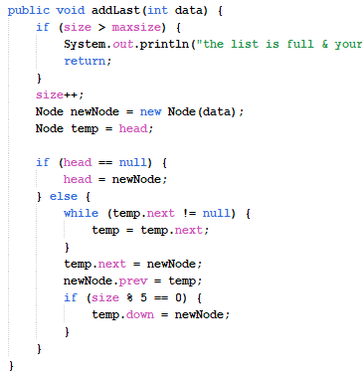
(addLast) Function
Check if List is Full: It first checks if the current size of the list exceeds the maximum allowed size (maxsize). If so, it prints a message indicating that the list is full and the data cannot be added. Then it returns without adding the data to the list.
Increment Size: If the list is not full, it increments the size variable to reflect the addition of a new node.
Create a New Node: It creates a new node (newNode) with the provided data.
Handle Insertion When List is Empty: If the list is empty (head is null), it sets the head to the new node (newNode).
Insertion When List is Not Empty:
If the list is not empty, it traverses the list until it reaches the last node (temp.next == null).
It updates temp to point to the last node in the list.
It then sets the next pointer of the last node (temp.next) to point to the new node (newNode).
It sets the prev pointer of the new node (newNode.prev) to point back to the last node (temp), establishing the double linked list connection.
Additionally, if the size of the list is a multiple of 5 (indicating the end of a row in the tombola card layout), it sets the down pointer of the last node in the previous row to point to the new node. This pointer is used to navigate to the next row in the tombola card layout.
Overall, this function efficiently adds a new node to the end of the double linked list while also handling special cases such as a full list and the tombola card layout requirement.

Slide 8
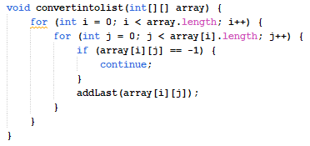
(convertIntoList) Funtion
Loop Over Rows and Columns: The function utilizes nested loops to iterate over each element in the 2D array. The outer loop (i) iterates over the rows, while the inner loop (j) iterates over the columns of each row.
Check for Valid Number: At each position in the array, it checks if the value is -1. If it is, it skips adding this value to the linked list and continues to the next iteration of the loop.
Add Number to Linked List: If the value is not -1, it invokes the addLast function to add the value to the end of the linked list. This function handles the addition of elements to the list while ensuring that the list remains within the specified maximum size and adheres to the tombola card layout constraints.
Traversal through 2D Array: This function essentially converts the 2D array representation of numbers into a linear sequence by adding them to the linked list one by one.
Overall, the convertintolist function efficiently populates the linked list with the numbers provided in the 2D array, skipping any invalid values (-1) and adhering to the maximum size constraint and tombola card layout requirements.

Slide 9
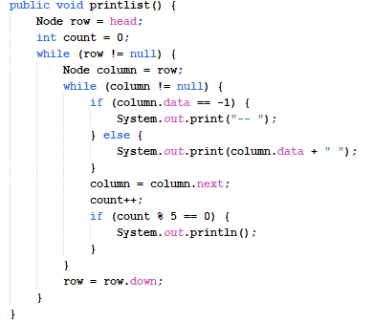
(printList) Function
The function iterates through the linked list, printing each node's data. If the data is -1, it prints "--" instead. After printing each row (which consists of five elements), it moves to the next row and continues printing until the end of the list.
Overall, the printlist function effectively formats and displays the linked list contents as a tombola card, with appropriate line breaks and placeholder characters for empty elements.

Slide 10
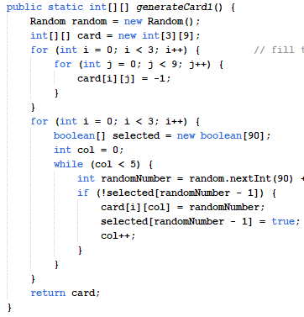
(generateCard) Funtion
Initialize Card Array: It initializes a 2D array called card with dimensions 3x9, representing the rows and columns of the tombola card.
Fill Card with -1: Initially, it fills the entire card with -1 to indicate empty spaces.
Generate Random Numbers: For each row (3 rows in total), it generates 5 unique random numbers between 1 and 90 to fill in the card columns. It uses a boolean array selected to keep track of numbers that have already been selected to avoid duplicates.
Assign Random Numbers to Card: It assigns the generated random numbers to the card, ensuring uniqueness within each row. It sets the value of selected[randomNumber - 1] to true to mark the number as selected. The loop continues until five unique numbers are selected for each row.
Return Card: Finally, it returns the generated card.
This method effectively generates a tombola card for a user, ensuring that each row contains five unique numbers selected randomly from the range 1 to 90.

Slide 11
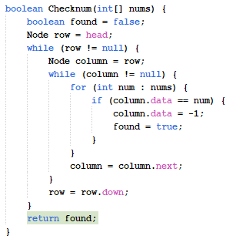
(checkNum) Function
Initialization: It initializes a boolean variable found to false to track whether any of the provided numbers are found in the linked list. It starts traversing the linked list from the head node (row).
Traversal: It iterates over each node in the linked list using nested while loops. The outer loop (row) iterates over each row of the linked list. The inner loop (column) iterates over each column in the current row.
Check for Numbers: Within the inner loop, it iterates over the numbers provided in the nums array. For each number, it compares it with the data in the current node (column.data). If a match is found, it sets the data of the current node to -1, indicating that the number has been marked as found. It updates the found variable to true if any of the provided numbers are found in the linked list.
Move to Next Node: After processing each node in a row, it moves to the next node in the row (column = column.next).
Move to Next Row: After processing all nodes in a row, it moves to the next row by setting row to the next row (row = row.down).
Return Result: Finally, it returns the value of found, indicating whether any of the provided numbers were found in the linked list.
This method efficiently searches for numbers in the tombola card linked list and marks them as found by setting their data to -1. It returns true if any of the provided numbers are found, otherwise, it returns false.

Slide 12
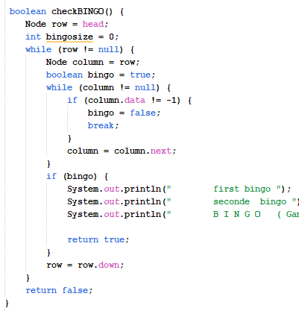
(checkBingo) Funtion
Initialization: It starts by initializing a pointer row to the head of the linked list and a variable bingosize to 0 to track the number of BINGO occurrences.
Traversal: It iterates over each row of the tombola card using a while loop (row). Inside this loop, it initializes a pointer column to the current row (row).
Check for BINGO in Each Row: For each row, it checks if all elements in that row are marked as -1 (indicating they have been matched). If all elements in the row are -1, it sets bingo flag to true, indicating a BINGO. It breaks out of the inner loop if any non-matching element is found in the row.
Handle BINGO Condition: If a BINGO is found (i.e., bingo is true), it prints a message indicating the BINGO occurrence. It then returns true to indicate that a BINGO has been found and the game has ended.
Move to Next Row: After checking each row, it moves to the next row of the tombola card by updating the row pointer to the next row (row = row.down).
Return Result: If no BINGO is found after checking all rows, it returns false, indicating that the game is still ongoing.
This method effectively checks for a winning condition in the tombola card represented by the linked list and terminates the game if a BINGO is detected. If no BINGO is found, it returns false to continue the game.

Slide 13
Classes and Functions :
c. BINGO Class: This class serves as the entry point for the game. Key functions include:
Initialization: It creates instances of the Scanner class to take input and two instances of the doubleLinklist class to represent the tombola cards for each player.
Create Tombola Cards: It initializes the first player's card (card1) with predetermined numbers and converts it into the linked list using the convertintolist method. It generates the second player's card (card2) using the generateCard1 method from the doubleLinklist class and converts it into the linked list.
Game Loop: It enters a while loop to simulate the game until a player wins (BINGO is detected). Within each iteration of the loop: It displays the tombola cards for both players. It prompts the user to press Enter to draw numbers. It generates random numbers using the randomNumbers method. It checks the drawn numbers against both players' cards using the Checknum method. It checks for a BINGO condition using the checkBINGO method for both players. If a player wins (BINGO is detected), it prints a message declaring the winner and ends the game.
Random Numbers Generation: It uses the randomNumbers method to generate an array of random numbers for each draw.
Overall, the BINGO class effectively simulates a game of BINGO between two players, allowing them to mark numbers on their cards and detect a winning condition (BINGO). The game continues until one of the players achieves a BINGO.

Slide 14
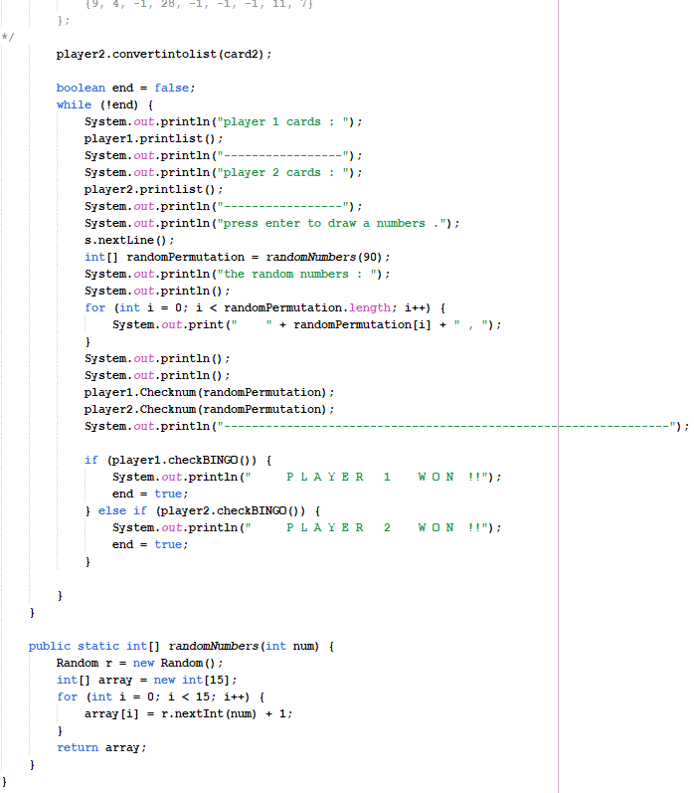
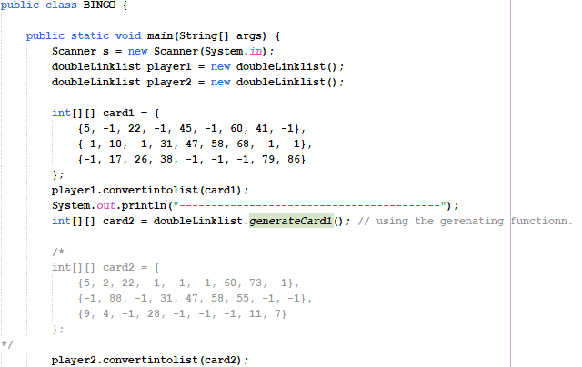

Slide 15
Game System Overview:
The Tombola game involves two players, each with a card containing 15 numbers arranged in three rows. The game proceeds as follows:
Players' cards are initialized either manually or randomly generated.
Random numbers are drawn without replacement, simulating the drawing of numbers in the actual game.
Players mark off numbers on their cards as they match the drawn numbers.
The game continues until one player achieves a bingo pattern (i.e., marks all numbers in his own card completely).
Upon achieving bingo, the player shouts "Bingo," signaling the end of the game.

Slide 16
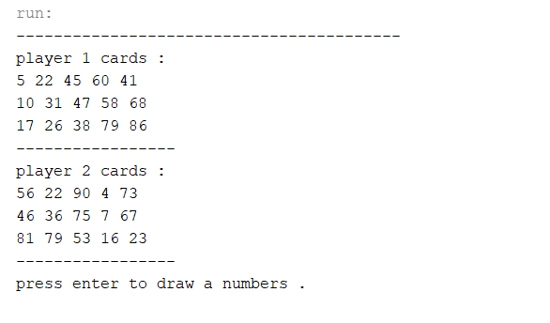
TEST

Slide 17
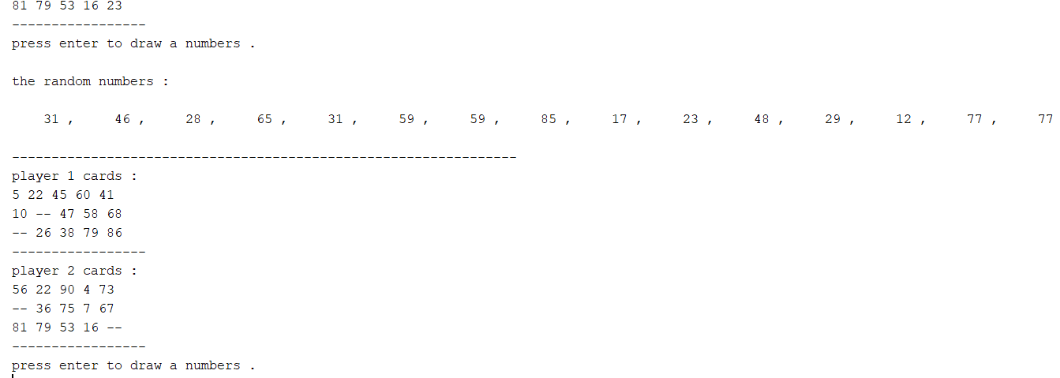

Slide 18
